Slide 1


Crime in Chicago
Analysis of types of crimes and community areas

Slide 2
Objectives
Define area crimes
Define community areas and crimes in Chicago
Get insights
Clustering of areas according to most common venues. Analysis of types of crimes per area.
Provide results
Conclusions and results from analysis to provide recommendations.

Slide 3
Introduction
Moving to a new place
Quantifying the safety of an area
Know which types of crimes you are more likely to face in that area

Slide 4
Data
Crime data from the city of Chicago
Location
Type of crime
Community area number
Data about community areas in Chicago
Geospatial information
Community area number and name
Foursquare data about venues in Chicago’s neighborhoods

Slide 5
Methodology
Reduction of crime data
Dropping off n/a records
Selecting random sample of 0.1% (approximately 6000 rows)
Data merge
Getting community area names for each crime
Data clustering
Clustering by most common venues according to Foursquare
Combination of data
For each crime, location, type of crime, community area and most common venues

Slide 6
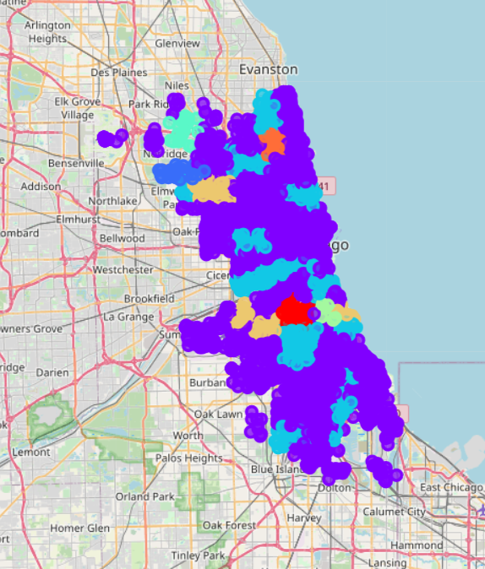
Results
Two main clusters in Chicago’s most common venues: Fast food restaurants and Bars
12.22% of crimes happened in an area which have Fast food restaurants as the most common venue
Not all types of crimes distribute equally among community areas

Slide 7
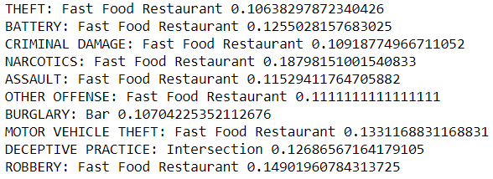
Discussion
Narcotics crime more frequent when the most common venue is Fast food restaurant
Burglary crime more frequent in areas where Bars are the most common venue
Deceptive practice more likely to happen in community areas with lots of intersections

Slide 8
Conclusion
There is a correlation between the type of crime and the most common venue in a community area
You can prepare to face specific crimes depending on the most common venue in a neighborhood
This information is useful not only when moving to a new place, but also when traveling to new cities
Main limitation of this study is the limited number of rows used. More accurate conclusions if more rows are used

Slide 9
Thank you for your attention

